Slide 1
DaVita
Dialysis Patient
Hospitalization
Analysis
1,311
9
Patients
Facilities
9,106
1,264
Sr. Analyst, Tableau Development
Case Study | July 2017 – June 2018
Washington (Region A) & Alabama (Region B)
Member-Months
Total Admits
1,311 Patients | 9 Facilities
Garon Alexander
Washington (Region A) vs Alabama (Region B)
Washington (A)
Alabama (B)
Notes:
This presentation analyzes 12 months of dialysis patient data across two regions to identify hospitalization drivers, regional performance gaps, and actionable next steps for care model improvement.

Slide 2
Dataset Overview
Source: 5 Relational Tables · July 2017 – June 2018 · 9,106 Member-Months
Source
5 relational tables: Treatment Info, Demographics, Labs, Admit Info, Facility Info
Table
What It Contains
treatment_info
Monthly treatments, missed Tx, access type
Timeframe
July 2017 – June 2018 (12 months)
demographics
Age, sex, race, dialysis start date
Patients
1,311 unique members — 750 Male (57.2%) · 561 Female (42.8%)
labs
Albumin, hemoglobin, hematocrit, KTV
Regions
Washington (Region A — 4 facilities, 809 patients) & Alabama (Region B — 5 facilities, 502 patients)
admit_info
Inpatient admits, BSI events
Race Mix
White 49.1% · Black 19.8% · Hispanic 19.5% · Other 9.5% · Asian 2.1%
facility_info
Facility ID, state, region, schedule
Key Metrics
Hosp. admits, KTV dialysis dose, missed treatments, albumin, BSI events, CVC vs non-CVC access
Each row = one patient in one month (a "member-month"). Data imported into PostgreSQL — queried with Custom SQL to power all Tableau dashboards.
Notes:
Each row in the joined dataset represents one patient in one month (a 'member-month'). Total member-months = 9,106. Data imported into PostgreSQL and queried using custom SQL to power all Tableau dashboards.

Slide 3
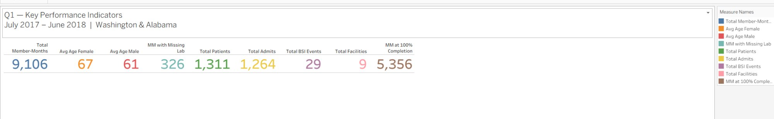
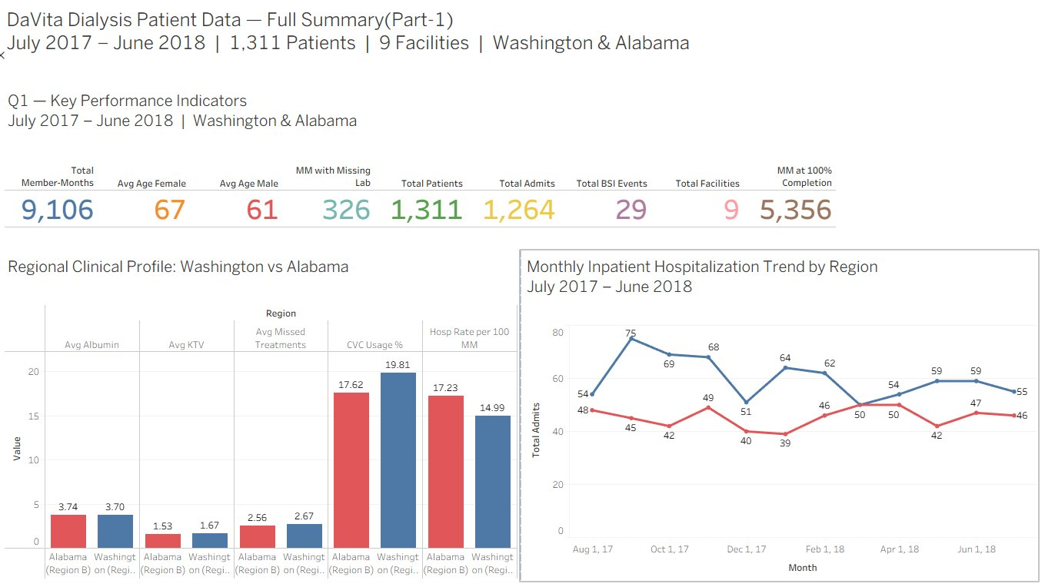
Q1 — Data Summary: Key Performance Indicators
Q1
July 2017 – June 2018 | Washington & Alabama | 9,106 Member-Months
Regional Comparison
Metric
WA (A)
AL (B)
Hosp Rate /100MM
14.99
17.23
Avg KTV
1.67
1.53
Avg Albumin
3.70
3.74
Missed Tx
2.67
2.56
CVC Usage %
19.81%
17.62%
AL hosp rate (17.23) is 15.1% higher than WA (14.99)
WA has better KTV adequacy (1.67 vs 1.53) — stronger dialysis dose
29 BSI events; WA higher CVC use (19.81%) but lower admit rate
Notes:
Alabama's hospitalization rate of 17.23 per 100 MM is significantly higher than Washington's 14.99. Alabama underperforms on KTV adequacy. Washington has higher CVC usage but still outperforms — suggesting CVC access alone is not the only driver.

Slide 4
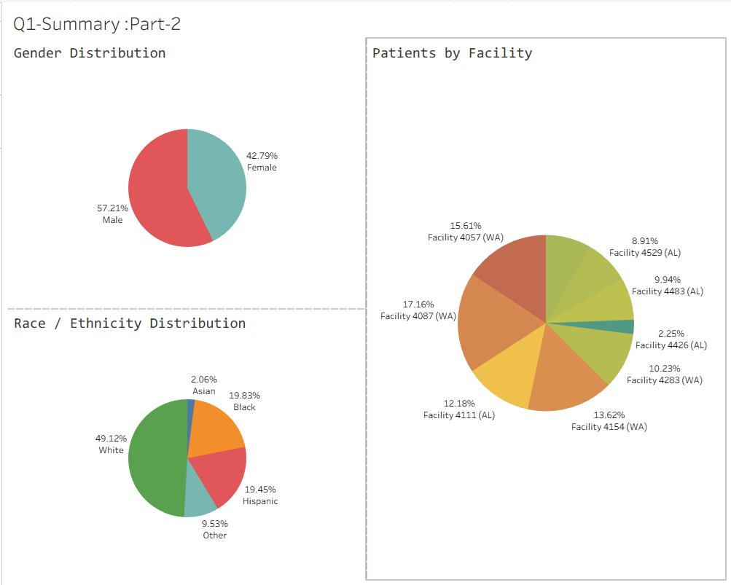
Q1 — Who Are Our Patients?
Q1
Demographics Overview | 1,311 Patients | Washington & Alabama
Gender Distribution
Male
57.21% (750)
Female
42.79% (561)
Race / Ethnicity Distribution
White
49.12%
Black
19.83%
Hispanic
19.45%
Other
9.53%
Asian
2.06%
Facilities 4087 & 4057 (WA) serve ~33% of all patients. Admit rates are similar across racial groups — gap is clinical, not demographic.
Notes:
57/43 male-to-female split is typical for ESRD. Racial composition differs by region — Washington has large Hispanic population (227) while Alabama is predominantly White + Black. Hospitalization rates are similar across racial groups — confirming the performance gap is driven by clinical and operational factors.

Slide 5
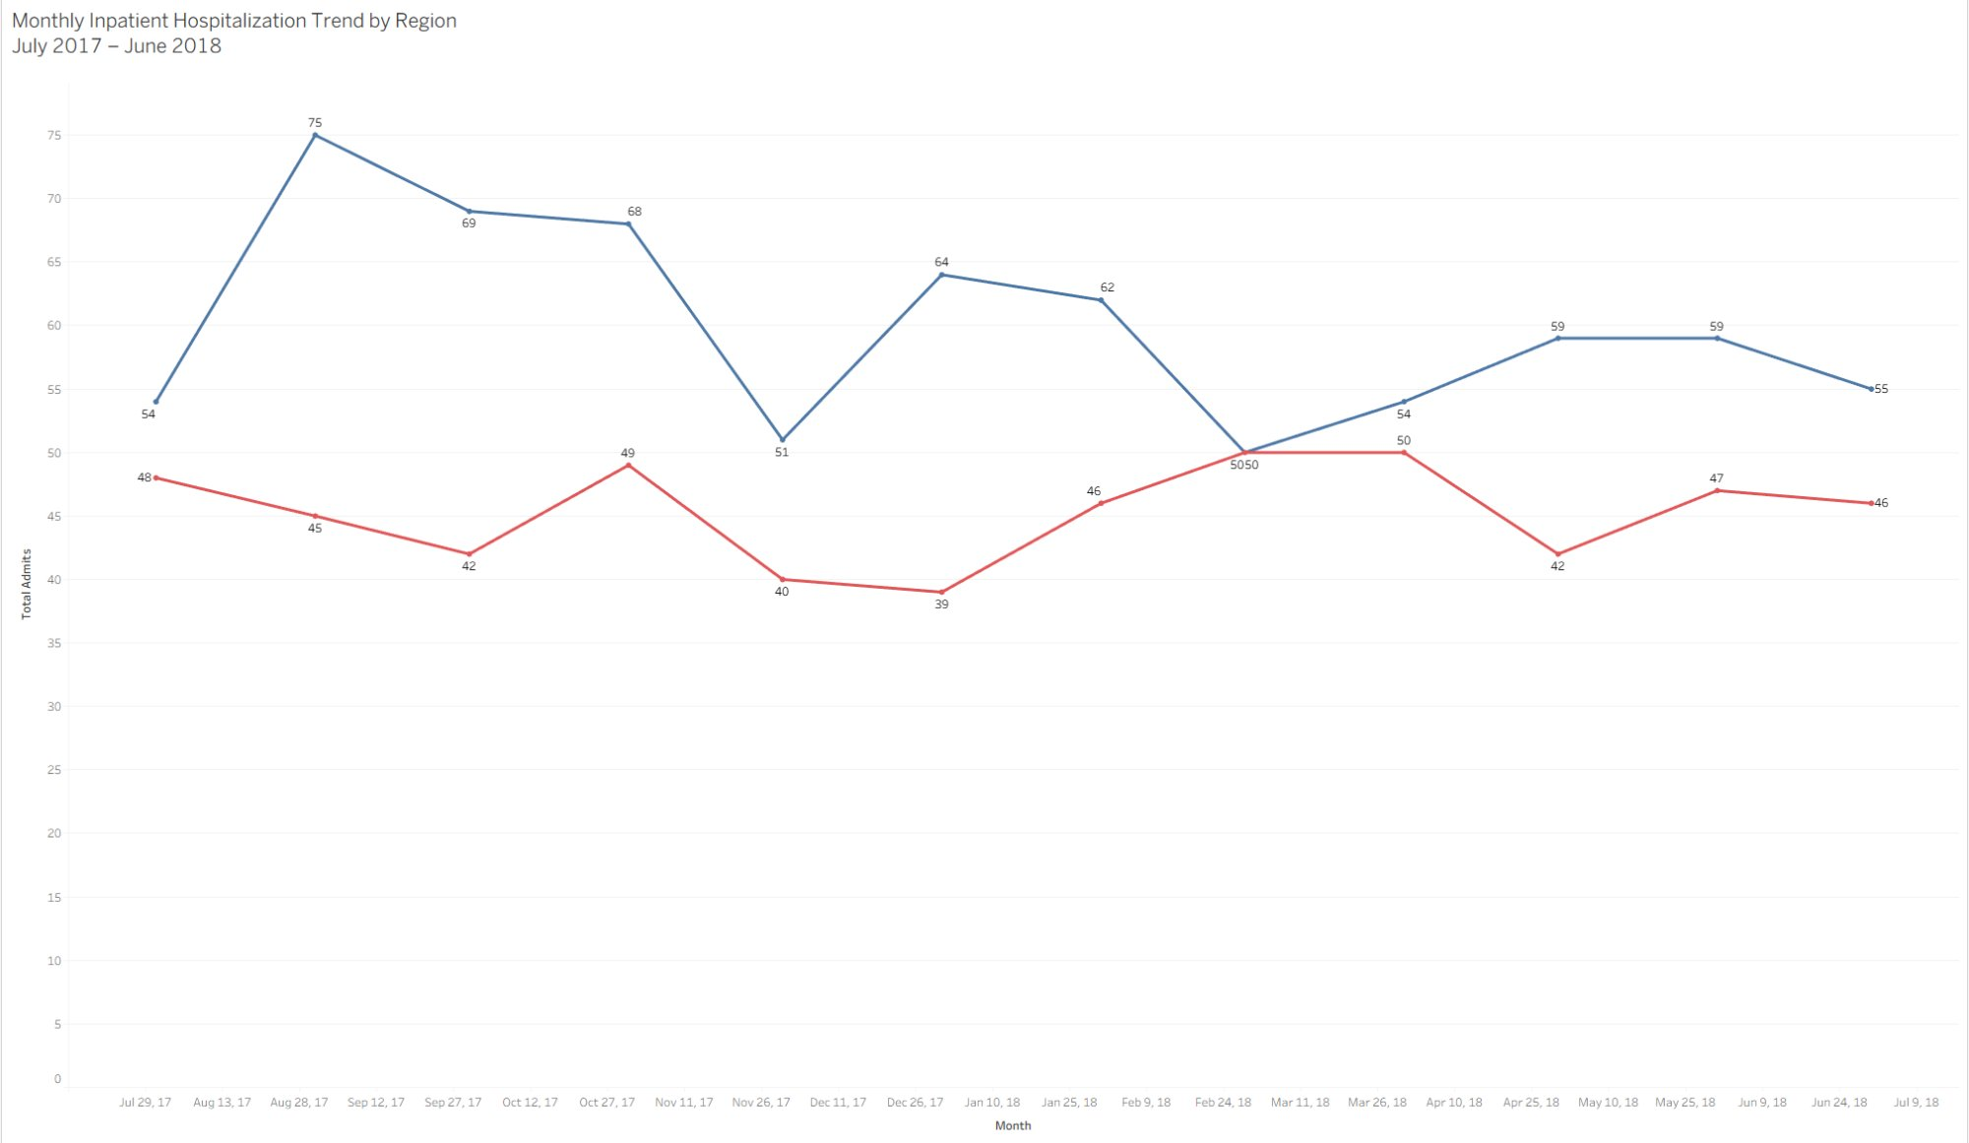
Q1 — Monthly Hospitalization Trend
Q1
July 2017 – June 2018 | Total Admits by Month | Washington (Region A) vs Alabama (Region B)
Washington (A)
Alabama (B)
WA peaked at 75 admits in Aug 2017, then trended down
AL stayed between 40–52/month — more stable but persistently elevated
Both regions bottomed in Nov–Dec 2017 (WA: 51, AL: 40)
Jun 2018: WA 55 vs AL 46 — gap narrows but persists all 12 months
Key Insight: The sustained gap across all 12 months confirms this is a structural — not seasonal — problem requiring systematic clinical intervention.
Notes:
Washington's high admit count is partly driven by the August 2017 spike (75). Alabama's pattern is more consistently elevated. The sustained gap across all 12 months confirms this is structural — not seasonal.

Slide 6
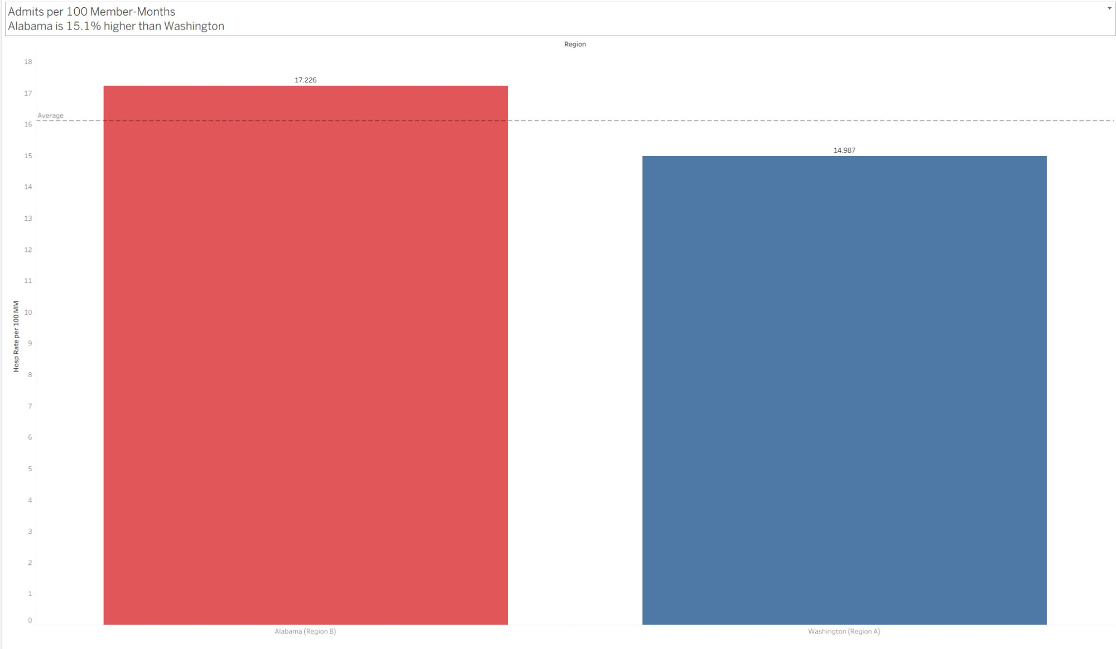
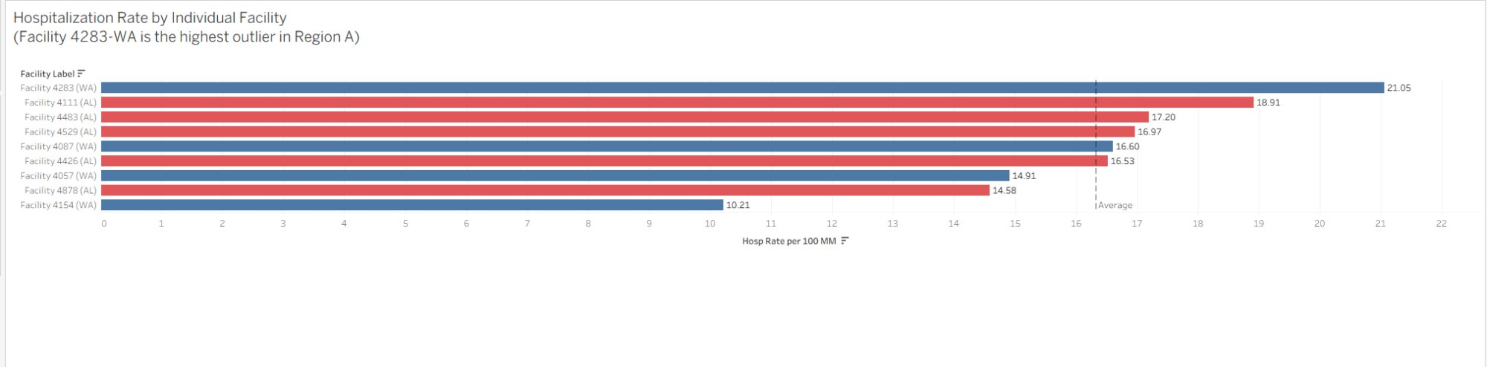
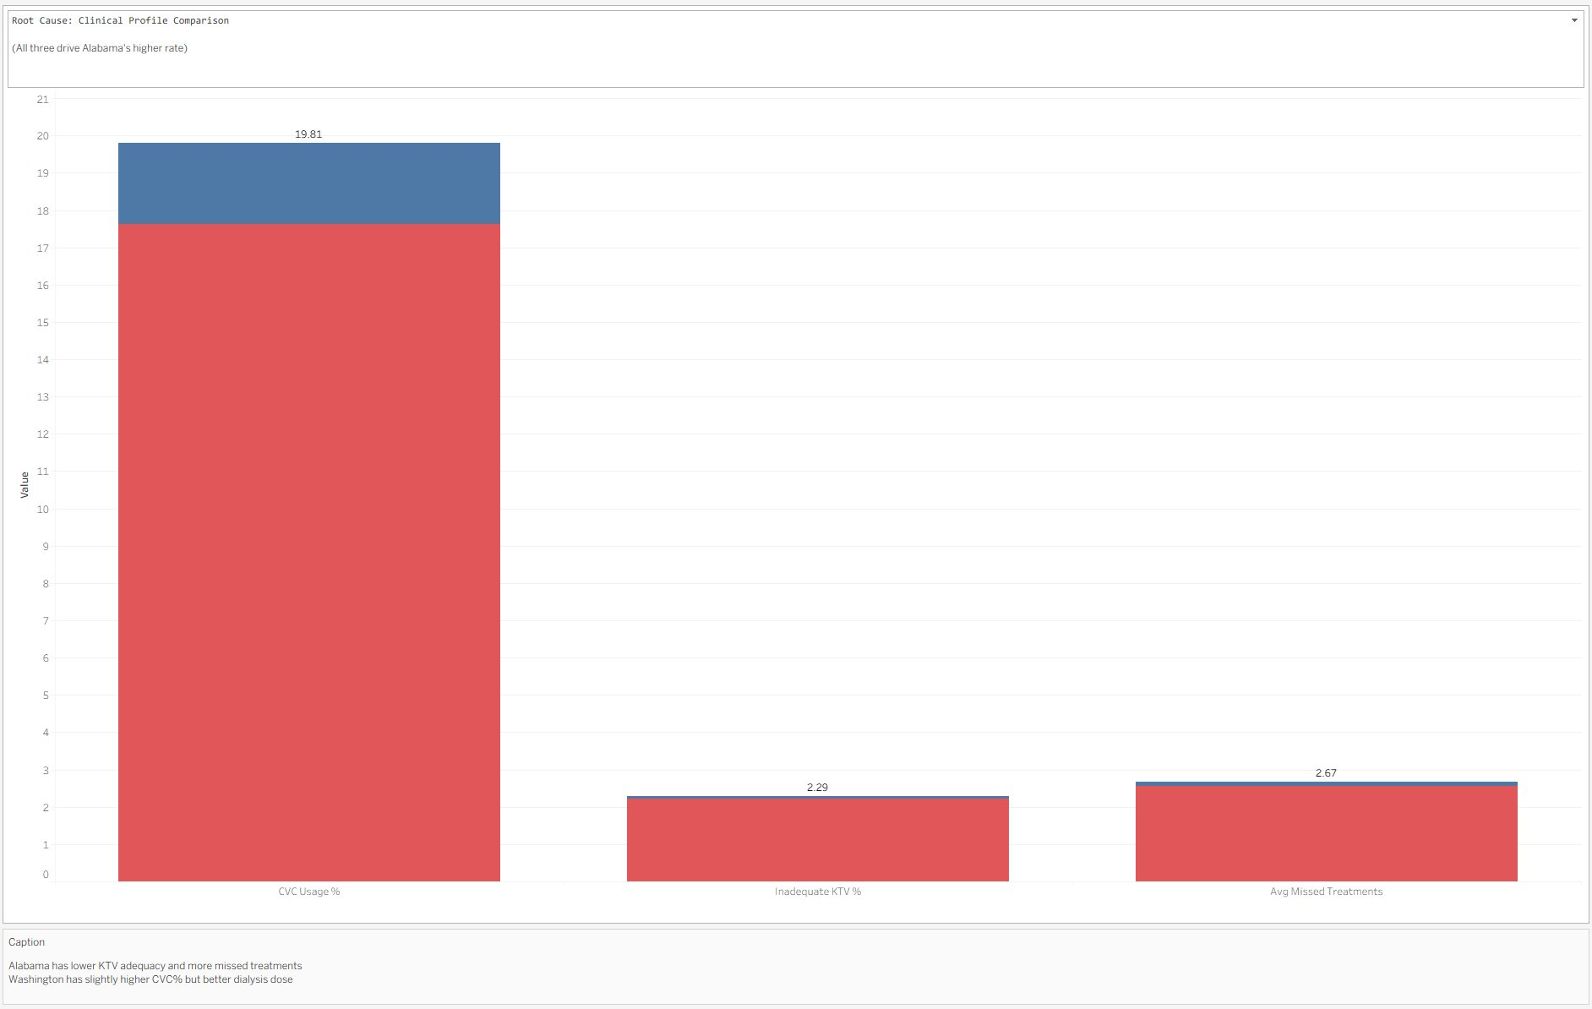
Q2 — Regional Comparison: Washington vs. Alabama
Q2
Hospitalization Rate | Root Cause Analysis | Facility-Level Breakdown
Alabama's hospitalization rate is 15.1% HIGHER than Washington's (17.226 vs 14.987 per 100 MM)
Metric
WA (Region A)
AL (Region B)
Direction
Hosp Rate / 100MM
14.987
17.226
AL +15.1% ↑
Avg KTV (Dialysis Dose)
1.67
1.53
WA better +9.2%
Avg Albumin (g/dL)
3.70
3.74
Similar
CVC Usage %
19.81%
17.62%
WA higher
Inadequate KTV %
2.22%
2.29%
AL slightly worse
Notes:
Alabama's 15.1% higher rate is Q2's central finding. Root cause: lower KTV adequacy (1.53 vs 1.67). Facility 4283 (WA) at 21.05 is the highest outlier. Facility 4154 (WA) at 10.21 is the benchmark to target.

Slide 7
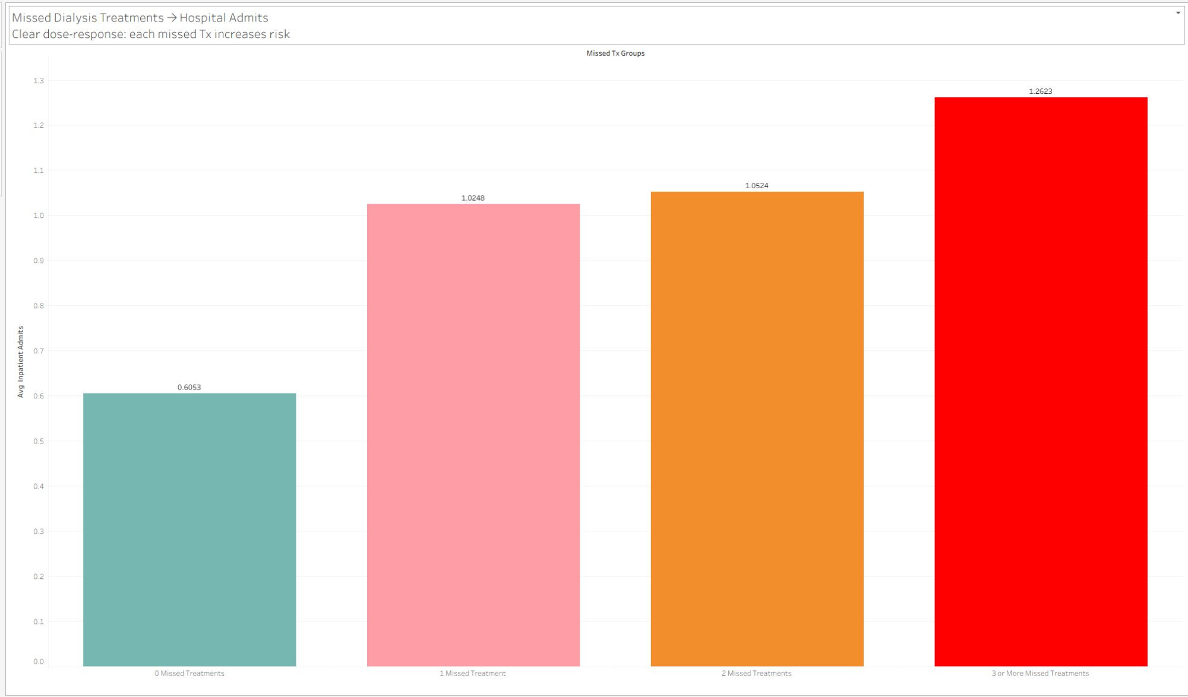
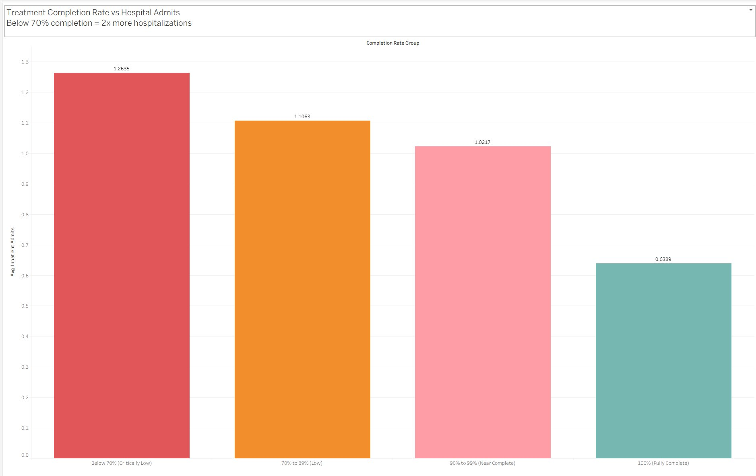
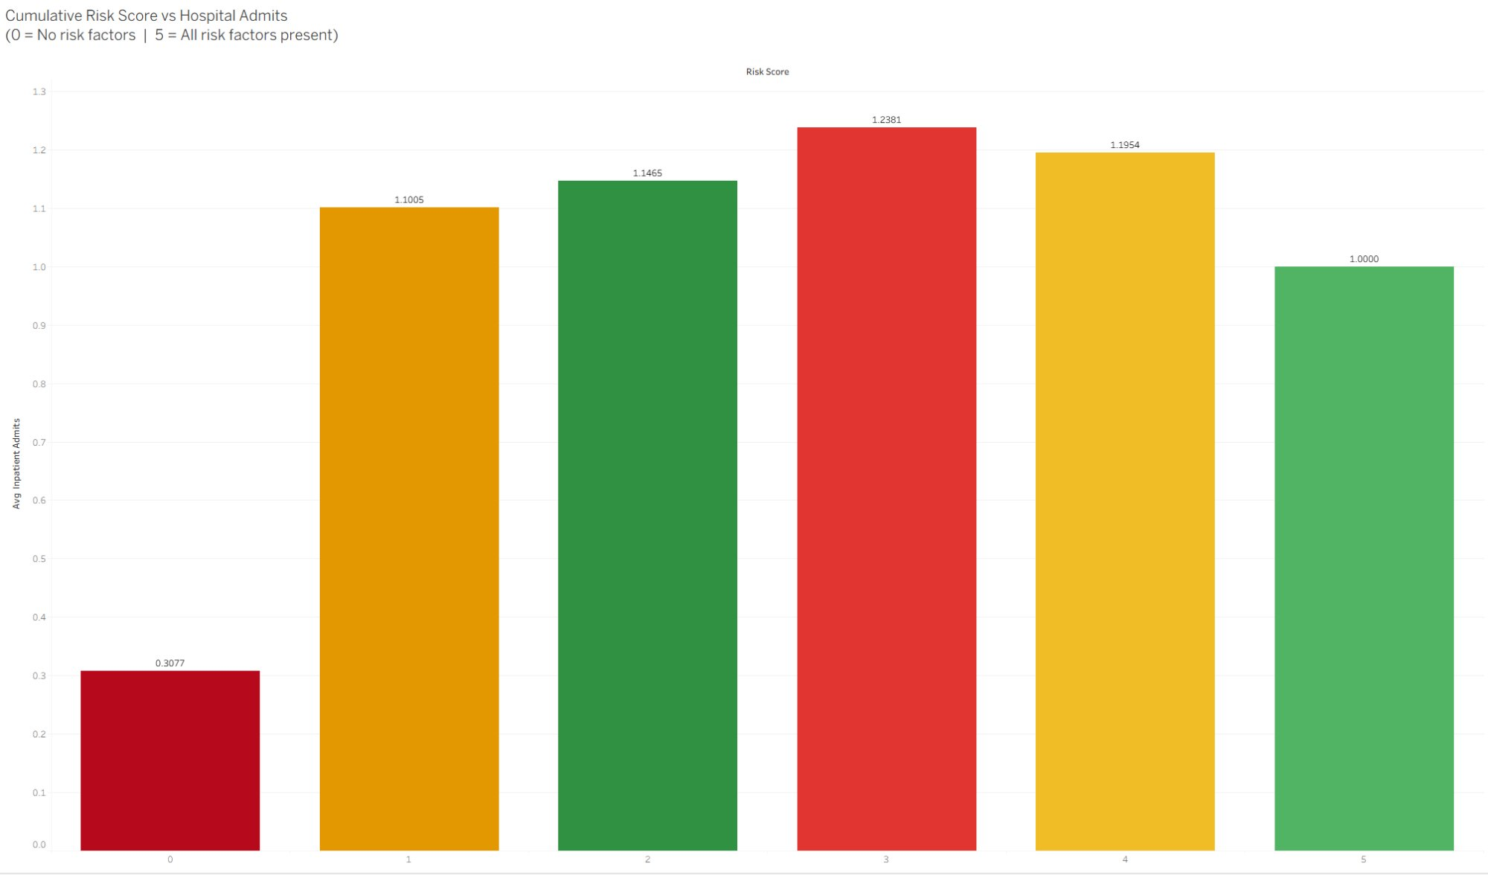
Q3 — Key Drivers of Hospitalization Rates
Q3
Dose-Response Effect | Treatment Completion Impact | Cumulative Risk Score
Driver 1: Missed Treatments
Driver 2: Completion Rate
Driver 3: Cumulative Risk Score
2
× more admits for members with
3+ missed Tx vs. zero missed
2
× more hospitalizations when
treatment completion < 70%
4
× admit rate at Risk Score 3
vs. zero risk factor members
Notes:
Three modifiable factors explain hospitalization variation: missed treatments, completion rate, and composite risk score. Members at risk score 3 have 4× the admit rate of zero-risk members — all addressable through targeted care management.

Slide 8
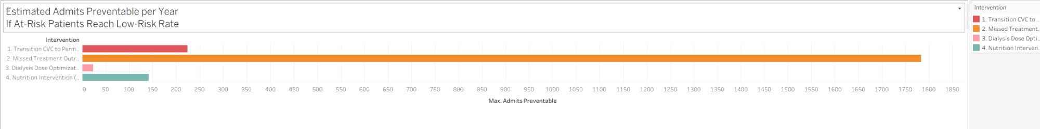
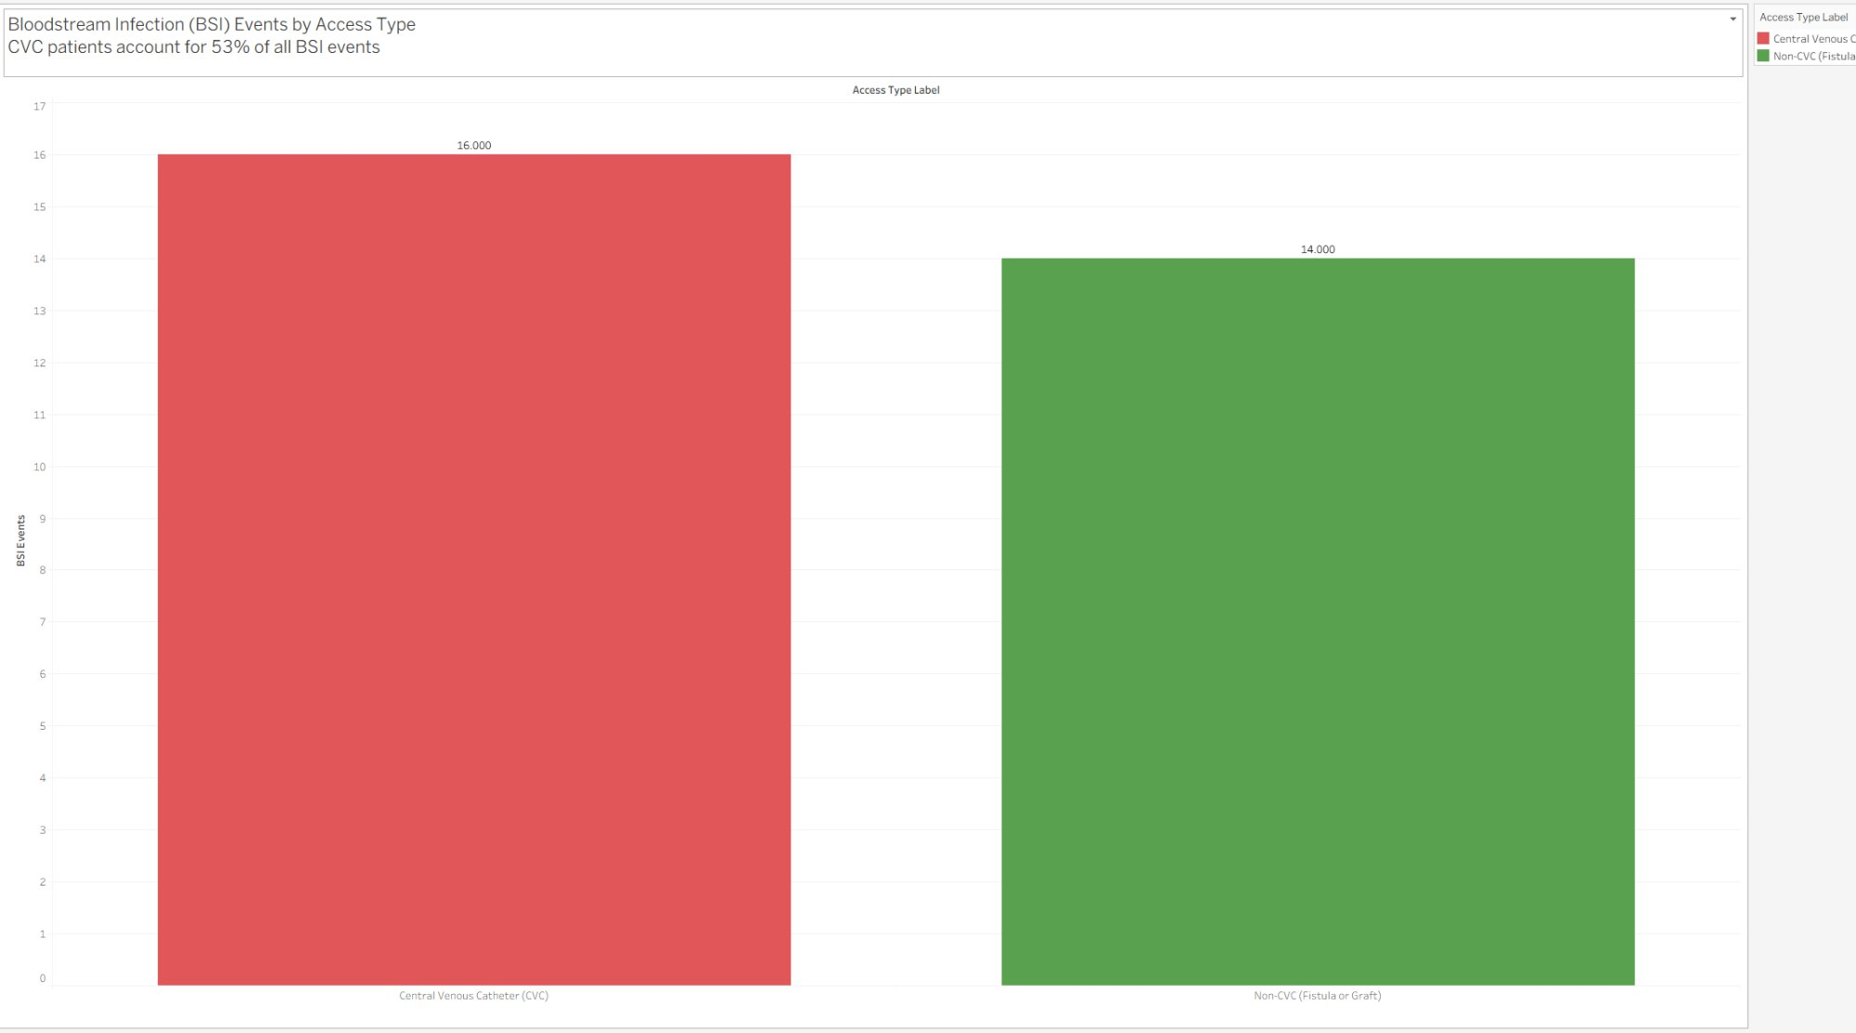
Q4 — Proposed Next Steps & Intervention Priorities
Q4
Ranked by Potential Reduction in Inpatient Hospital Admissions
Intervention Priority Ranking
1
Missed Treatment Outreach Program
Highest preventable admit volume (~1,800 admits/year potential)
2
Transition CVC → Permanent Access
Fistula/Graft — strong BSI + admit reduction (~200 prevents)
3
Dialysis Dose Optimization (KTV ≥ 1.2)
Targeted clinical improvement — AL facilities first
4
Nutrition Intervention (Albumin ≥ 3.5 g/dL)
Dietitian review program for at-risk members
Immediate
Missed-treatment outreach — calls + transportation for members with 2+ missed Tx/month
60-Day
Vascular access coordinator referrals for all CVC patients — prioritize fistula/graft conversion
90-Day
Facility KTV audit — target Facility 4283 (WA) at 21.05 and Facility 4111 (AL) at 18.91
Notes:
CVC patients account for 53% of all BSI events despite representing less than 20% of member-months. Transitioning to fistula or graft addresses both BSI and hospitalization risk simultaneously. Missed treatment outreach has the highest estimated preventable impact.

Slide 9
Q5 — SQL Queries: Analytical Methodology
Q5
5 Core Questions · PostgreSQL · Custom SQL across 5 Tables
i. Average Age by Gender
ii. Distinct Members at Clinic 4057
SELECT sex,
ROUND(AVG(age), 1) AS avg_age
FROM demographics
GROUP BY sex;
SELECT COUNT(DISTINCT patient_id)
FROM treatment_info
WHERE facility_id = 4057;
→ Female: 66.9 yrs (561) | Male: 60.7 yrs (750)
→ 214 distinct members (16.3% of all 1,311 patients)
iii. Max & Min Treatments in 2018
iv. Member-Months with Missing Lab
v. Admits by Clinic — December 2017
SELECT MAX(total_tx), MIN(total_tx),
AVG(total_tx)
FROM treatment_info
WHERE EXTRACT(YEAR FROM month) = 2018;
SELECT COUNT(*)
FROM labs
WHERE albumin IS NULL
OR hemoglobin IS NULL
OR hematocrit IS NULL
OR ktv IS NULL;
SELECT facility_id,
SUM(inpatient_admits)
FROM admit_info
JOIN treatment_info
USING (patient_id, month)
WHERE month = '2017-12-31'
GROUP BY facility_id
ORDER BY 2 DESC;
→ Max: 24 | Min: 1 | Avg: 11.1 treatments per MM
→ SQL: 532 MMs (any lab null) | Tableau KPI: 326 (all labs null)
→ 119 total admits | Facility 4087 (WA) led with 25 admits
Notes:
All queries use standard ANSI SQL. Compound JOIN keys on patient_id AND month prevent duplication. EXTRACT(YEAR) for year filtering. COUNT DISTINCT for unique patient counts. Missing-lab difference: SQL uses OR logic (532), Tableau counts rows where ALL labs are null simultaneously (326) — both valid.

Slide 10
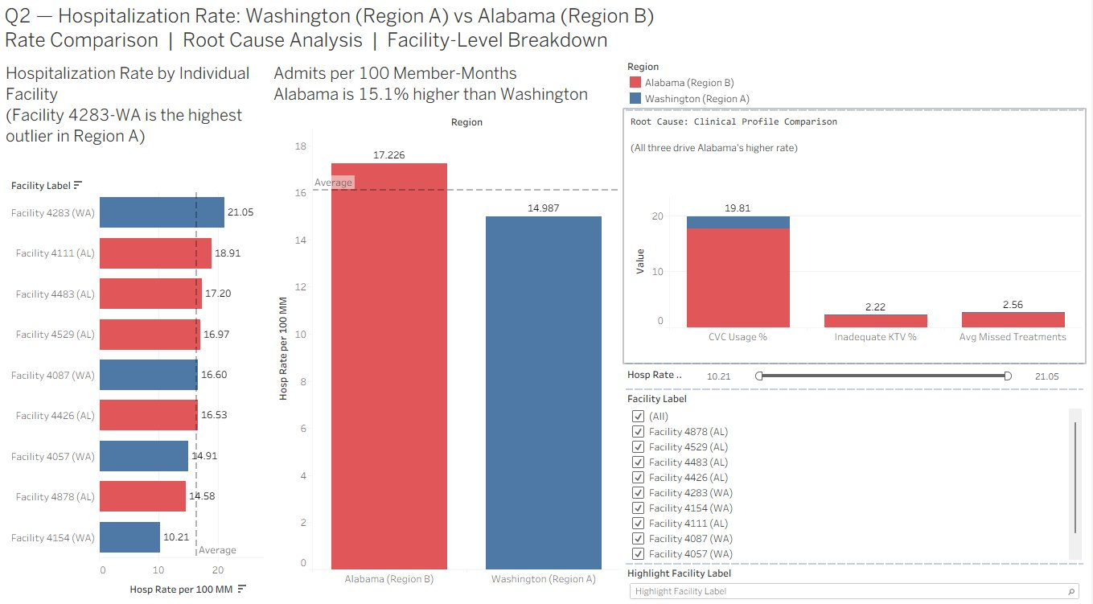
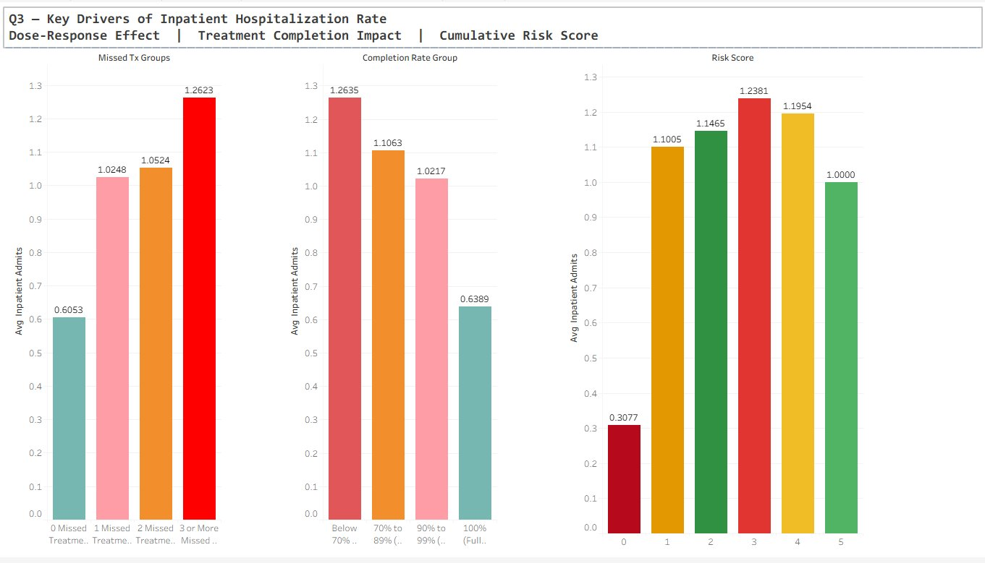
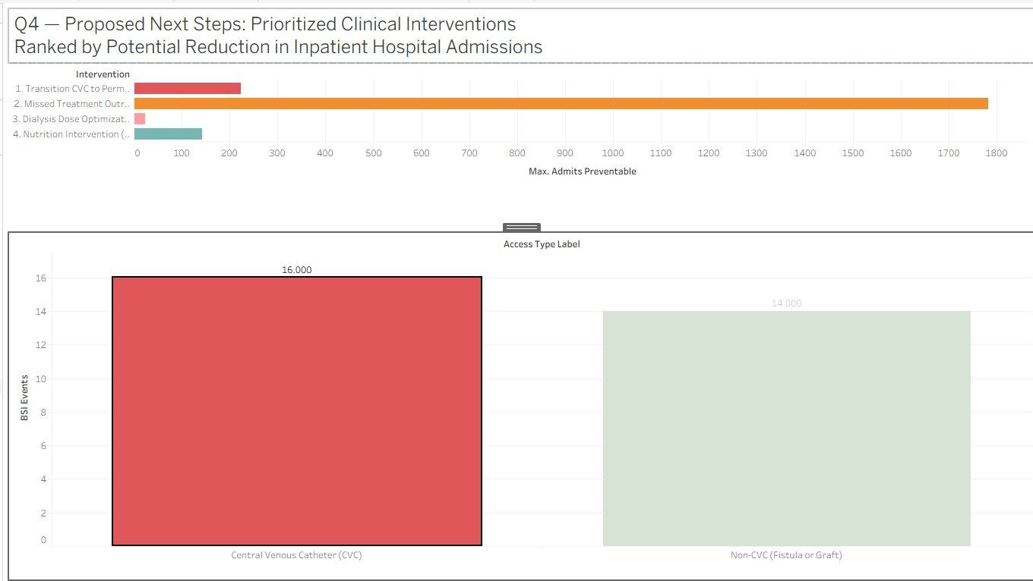
Tableau Dashboards — Live Interactive Reports
All Connected to PostgreSQL · Custom SQL · LOD FIXED Expressions · Filter by Region / Facility / Month
Q1 — KPI Summary
Q2 — Region Comparison
Q3 — Key Drivers
9,106 MMs · 1,264 Admits · AL 15.1% higher
AL=17.226 vs WA=14.987 · Facility 4283 outlier
3+ missed Tx = 2× admits · Risk 3 = 4× baseline
Q4 — Next Steps
Q6 — Demographics
CVC = 53% BSI events · Missed Tx = top priority
Male 57.21% · White 49.12% · Hispanic 19.45%
Custom SQL · LOD FIXED expressions prevent double-counting · Calculated fields validated against PostgreSQL · All KPI values confirmed accurate
Notes:
The Tableau dashboards are the primary deliverable. Each directly answers one case study question. LOD expressions were required because the LEFT JOIN data source creates row duplication — FIXED expressions ensure Total Admits and BSI Events are not double-counted.

Slide 11
Summary & Key Takeaways
01
Alabama's hospitalization rate (17.23) is 15.1% higher than Washington (14.99) — a structural, not seasonal, gap
“
02
3 primary drivers identified: missed treatments, low KTV adequacy, and CVC vascular access type
The data tells a clear story: the gap between Washington and Alabama is real, measurable, and — most importantly — fixable.
03
4 interventions prioritized — Missed Treatment Outreach has the highest impact (~1,800 admits preventable per year)
04
Tableau built on PostgreSQL with Custom SQL, LOD expressions & calculated fields — all KPI values validated
05
Ready to scale: dashboards can be extended to additional regions, facilities, or time periods with no rework required
— Garon Alexander
Notes:
Close by reinforcing that the analysis is prescriptive, not just descriptive. The dashboards give clinical and operational leaders the tools to act on specific, data-backed interventions. Emphasize ability to translate raw relational data into validated, actionable insights for both technical and executive stakeholders.

